Slide 1
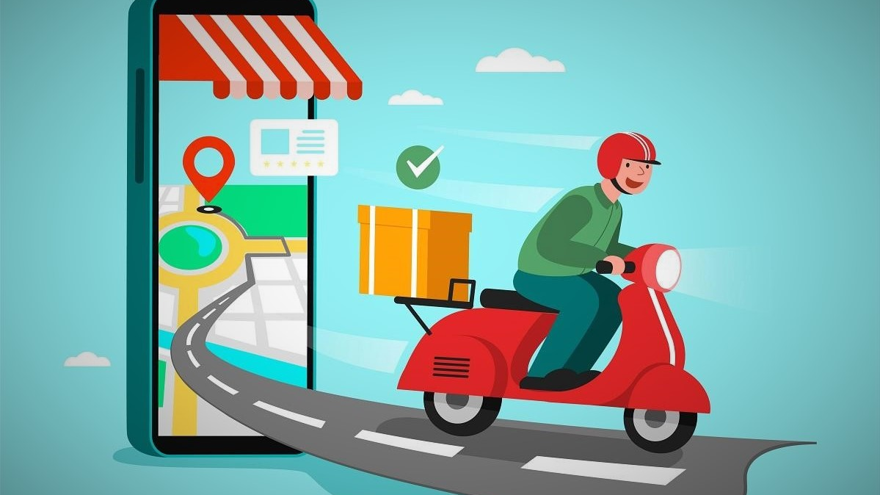
Courier Tracking Mobile Application
N.N.D.G. Liyanage
10707256

Slide 2
Introduction
Courier services mean any services provided to a customer, by a courier agency in relation to door-to-door transportation of time-sensitive documents, goods, or articles.
Within the country, the things can be imported through post-service. However, it consumes time and sometimes problem of damage or missing occurs. the courier service is one of the solutions of these problems. it is used to send some things to any person within time.
Developed a Mobile Application that provides a platform to tracking courier management system.
"Courier Tracking mobile application" is designed to avoid problems with the training manual system. This software helps to eliminate and, in some cases, reduces the complexity of the existing program.

Slide 3
Problem Statement
The first problem is difficulty in finding the location of customer and courier service.
There is no correct idea of the time between the goods being handed over to the courier service and to the customer. That means a waste of time and the courier service provider can’t manage the delivery of goods within working hours.
The third problem is the customer has no correct idea whether delivery charges are paid or not until the courier service provider meets the customer.
The fourth problem is that people in remote areas are unaware of the closest courier service center

Slide 4
Objectives
Provides search based on a variety of resources. Courier, tracking number, customer, address, etc.
The courier tracking system manages customer information, address details, and
online courier delivery information.
It monitors all information such as tracking, distribution, customer, etc.
Increasing efficiency of courier management, tracking
Responsible for customer information and performance monitoring.
Manage courier information
Improved editing, collection, and review of records, allowing for efficient management of courier data resources.

Slide 5
Aim of project
The main aim of the project is to develop an application system that meant to partially computerize the work performed by the department.

Slide 6
Advantages of courier tracking System
The tracking system enables you to have a better interaction process among delivery staff, fleet, and the customer.
This promotes an environment-friendly process, as it does not involve any paper use.
It assures an effective and transparent communication process.
Easy to manage all the daily transactions
Avoid human errors
Provides better customer support from any branch
Can generate required reports easily

Slide 7



Technologies used

Slide 8
Technologies used
Mobile Application
The mobile application was developed for the React native.
Availability of device – it was important to have access to a device on the selected platform as this can be used more efficiently in usability testing than an emulator.
Cost – Android Studio was free to use.
Popularity – Android is the most popular platform for development and because of this, offered mass online contributions and support.

Slide 9
Technologies used
Database
The database was implemented using firebase. Firebase is a NoSQL database for storing data in a Realtime Database. Firebase Realtime information base permits applications to move toward cross-stage information inside real-time subsequent to joining NoSQL distributed storage.

Slide 10
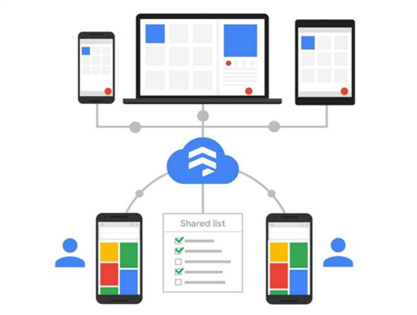
Technologies used
Firebase Cloud Firestore
Firebase Cloud Firestore comes in the form of a cloud-based NoSQL database server that excels at data storage and sync. In reality, native SDKs enable web and mobile apps to communicate directly with Firestore.

Slide 11
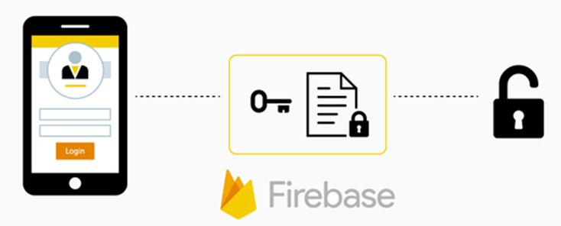
Technologies used
Firebase Authentication
To authenticate clients to applications, Firebase Authentication provides backend services, easy-to-use SDKs, and ready-made UI libraries. It supports authentication via email addresses, passwords, and phone numbers.

Slide 12
You can log into this courier tracking mobile application in 3 ways. As Admin, Customer and Rider. I will explain what features these 3 people have.

Slide 13
Admin
When talking about admin, it is admin who can enter parcel details. Only admin has the right to enter new orders data.
Only admin can see the rider list and customer list registered here as well as pending orders, ongoing orders, and complete orders.

Slide 14
Customer
When registered as a customer in this app, the admin can enter the data and check whether the respective customer's parcel is under pending orders or ongoing order at that time.
Customer can call the rider they want
An important feature here is that after the customer receives the parcel, when the QR is scanned by the rider, the admin can confirm that the parcel has been received by the customer.

Slide 15
Rider
When a rider registers in this app, he can view current orders, pending orders, and complete orders. Also, the call customer option has been provided to make it easier to contact the customer during parcel delivery. The rider can check the easiest route to the customer address, the travel time and the route through the google map.

Slide 16
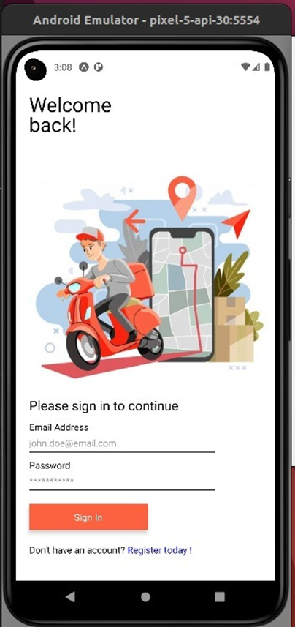
Mobile Application Features
This is the Main page of the courier tracking mobile application. The Admins, Riders and the Customers can login to this app by giving their own email and password to sign in. Users can log in to the system through the login page.

Slide 17
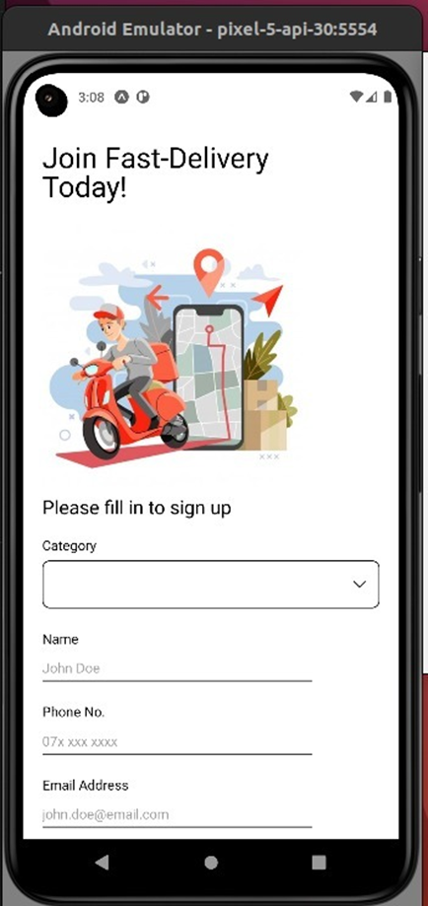
Mobile Application Features
Users can register into the system through the register page. The customers and riders can regiter by giving their Name, Phone number, Email and Password.

Slide 18
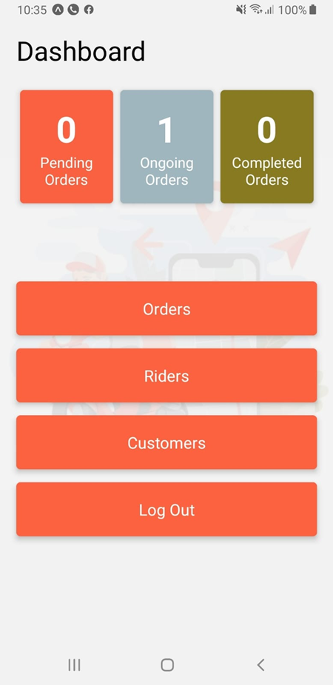
Mobile Application Features
Admin can view all number of orders, riders and customers registered in the system.

Slide 19
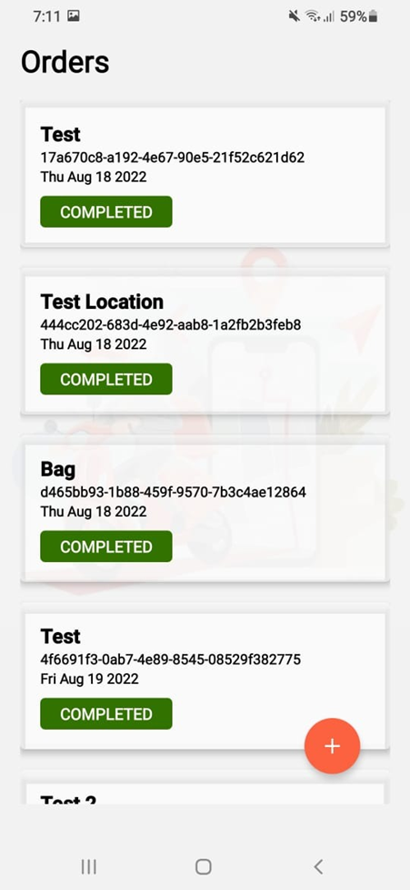
Mobile Application Features
Admin can view all courier orders registered in the system.

Slide 20
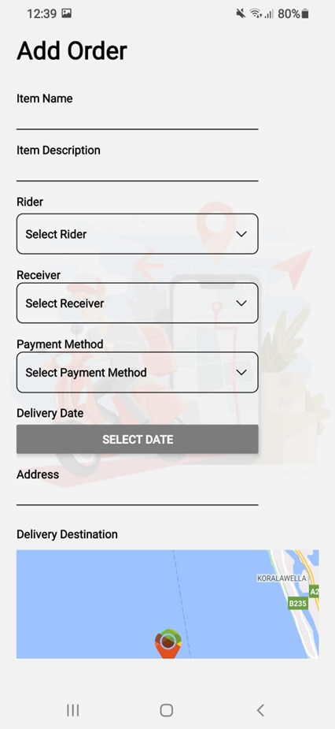
Mobile Application Features
By going the orders page admin can add new orders. To add an order admin to give the item name, item description, then admin can select a rider, by going to select a receiver mode the admin can select customer name, the next mode is the select payment method. You can select to cash on delivery or internet payment, then admin has to give receivers address and select delivery destination.

Slide 21
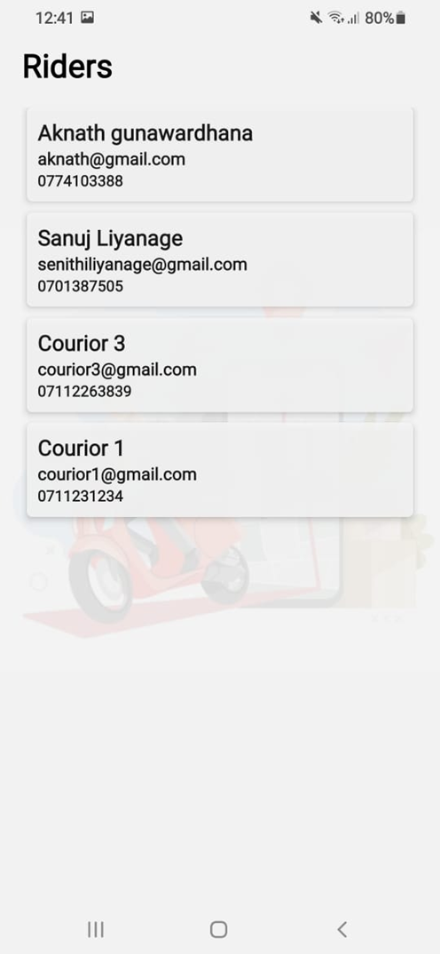
Mobile Application Features
Admin can view all Riders registered in the courier tracking mobile application.

Slide 22
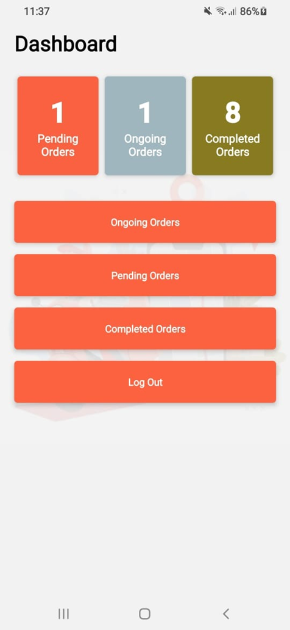
Mobile Application Features
Customer can login to this app. The customer can view ongoing orders, pending orders and complete orders in the courier tracking mobile application

Slide 23
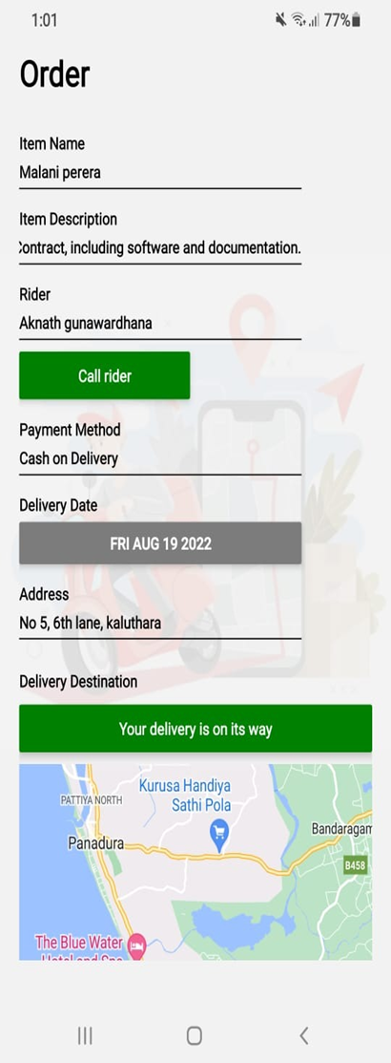
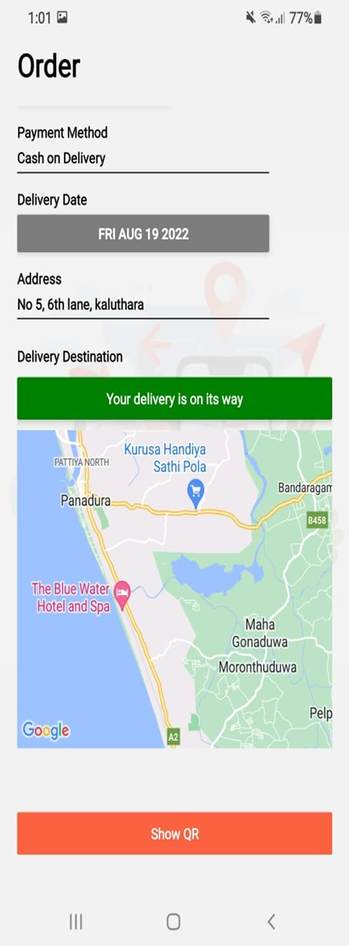
Mobile Application Features

Slide 24
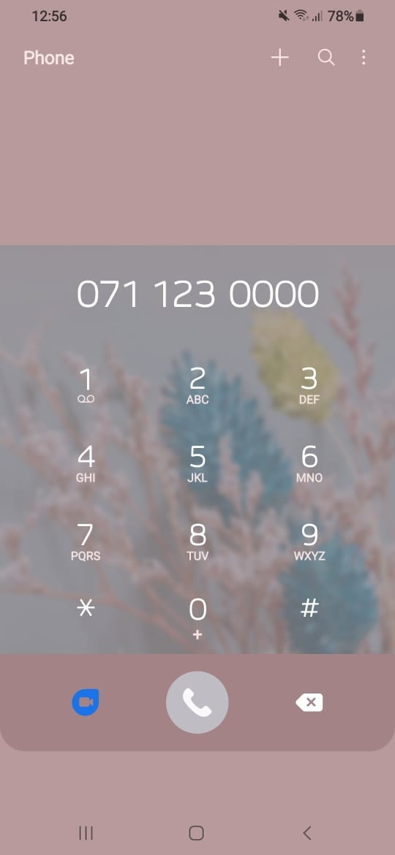
Mobile Application Features
Customers can call the riders they want.

Slide 25
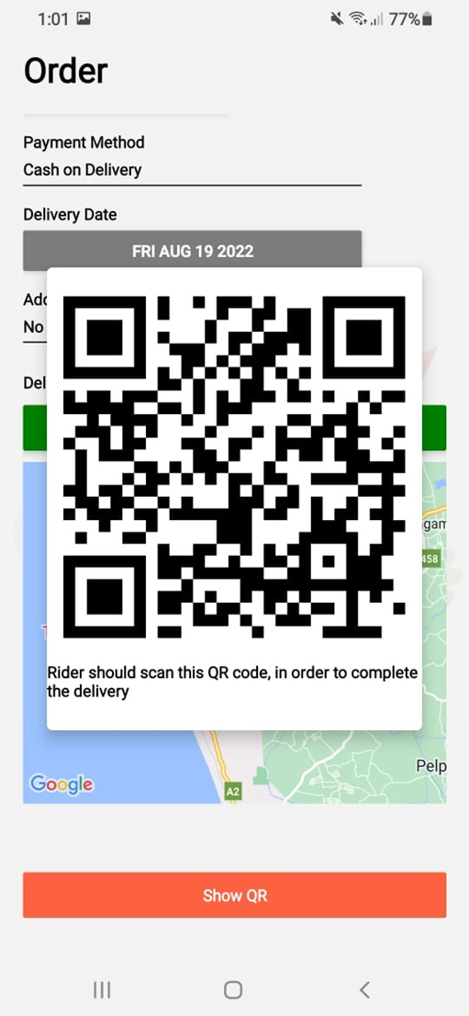
Mobile Application Features
An important feature here is that after the customer receives the parcel, when the QR is scanned by the rider, the admin can confirm that the parcel has been received by the customer.

Slide 26
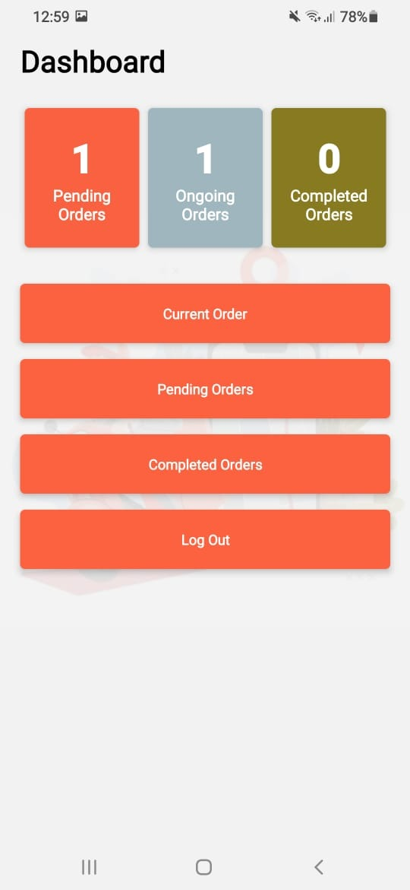
Mobile Application Features
Riders can login to this app. The Riders can view current orders, pending orders and complete orders in the courier tracking mobile application.

Slide 27
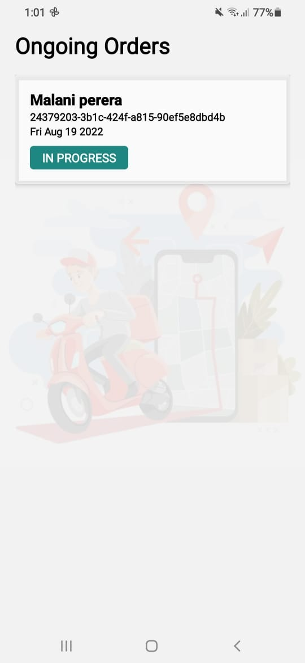
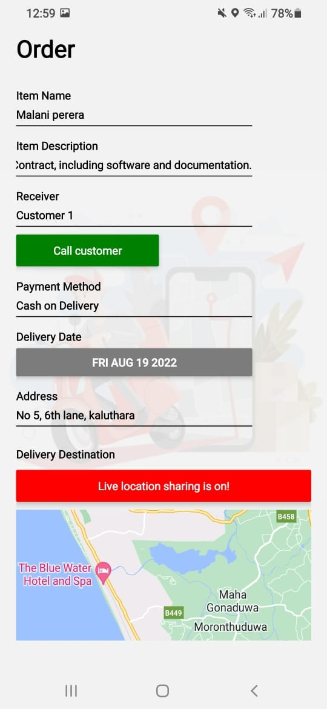
Mobile Application Features

Slide 28
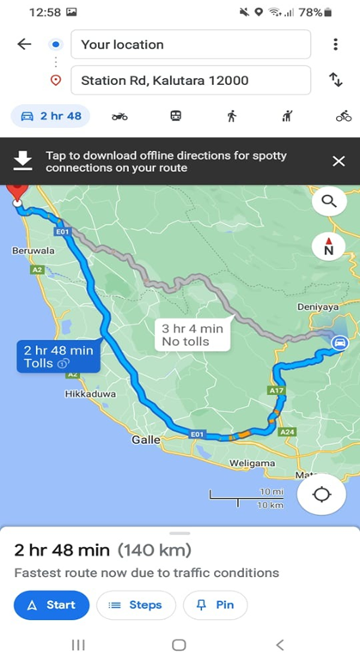
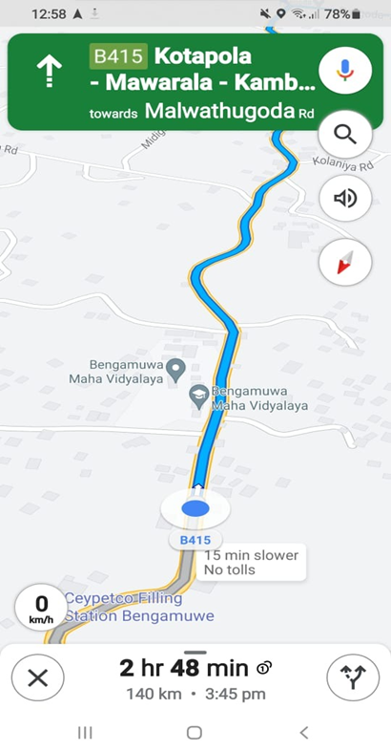
Mobile Application Features
Riders can get directions to the location of the desired customers.

Slide 29


